Slide 1
Capstone Project
Finance Predictive Analytics

Slide 2

Problem Statement
In the financial industry, it is crucial for lenders to assess the creditworthiness of borrowers before granting loans or credit. Identifying potential defaulters, who are at higher risk of failing to repay their debts, can help mitigate financial losses and maintain a healthy lending portfolio. The goal of this project is to develop a predictive model that can accurately classify borrowers as defaulters or non-defaulters based on various financial and demographic factors.

Slide 3
Research Objective
To create a machine learning model to predict the Defaulter and Non-defaulter by analyzing historical data.

Slide 4
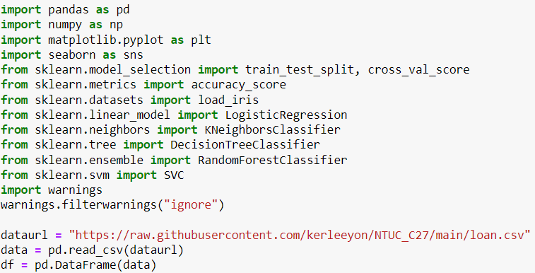
Importing Libraries and Loading the Data
Libraries | Purpose
Pandas | Data manipulation and analysis
Numpy | Numerical computing and mathematical operations
Matplotlib | Data visualisation and plotting
Seaborn | Statistical visualisation
Sklearn | Machine learning and predictive modelling

Slide 5
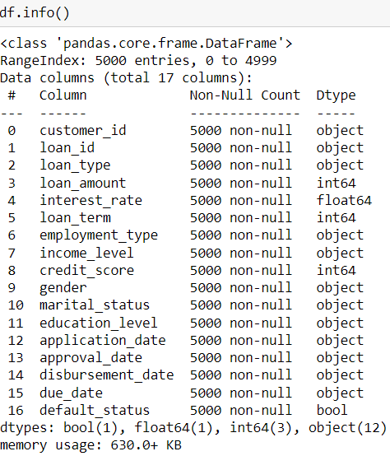
Exploratory Data Analysis (EDA)
Using df.info() in Pandas we obtain a summary of the DataFrame
From here we can observe that there are:
5000 rows
17 column names
Data types of each column
Since there are no null values in the DataFrame which we can proceed to do our visualization of the data to gather some more information on data, such as relationships among features, to check how our data is distributed.

Slide 6
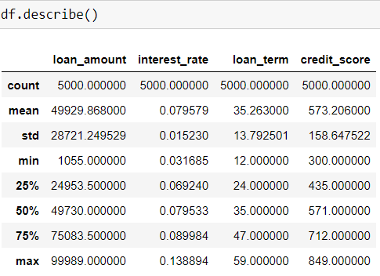
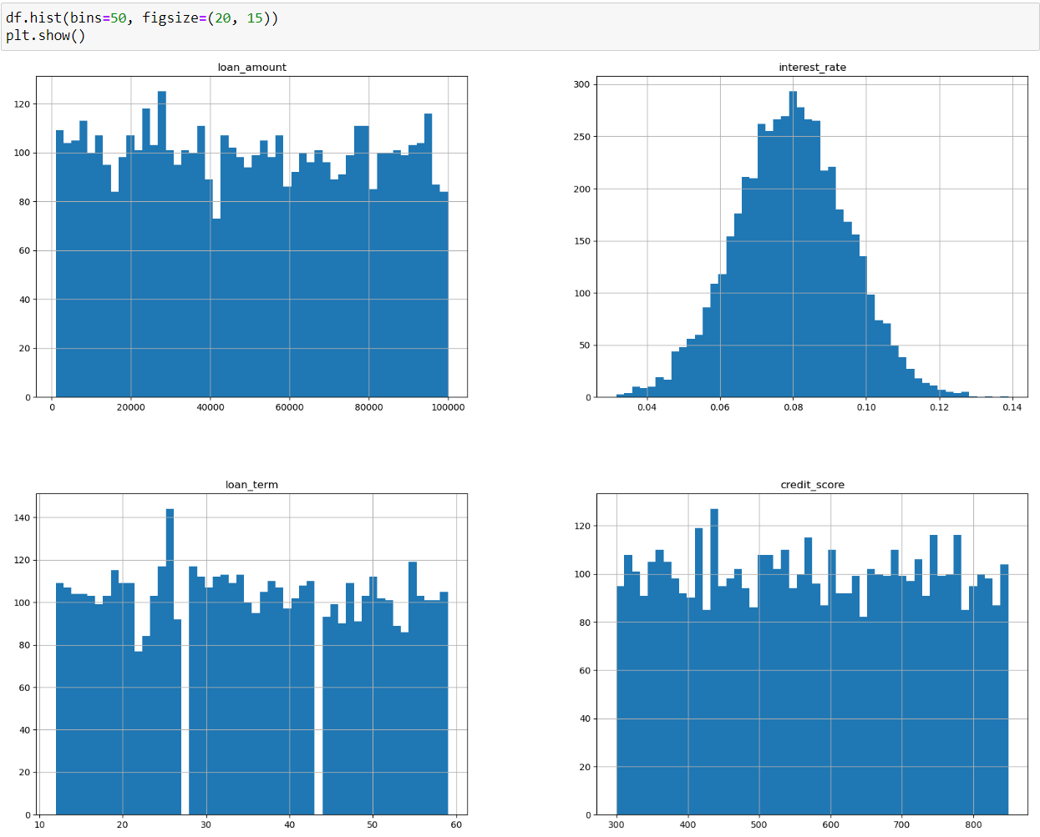
Exploratory Data Analysis (EDA)
df.describe() to get an overall sense of the data shape with the mean/median, min, max
df.hist() to visualize the distribution of our numerical data

Slide 7
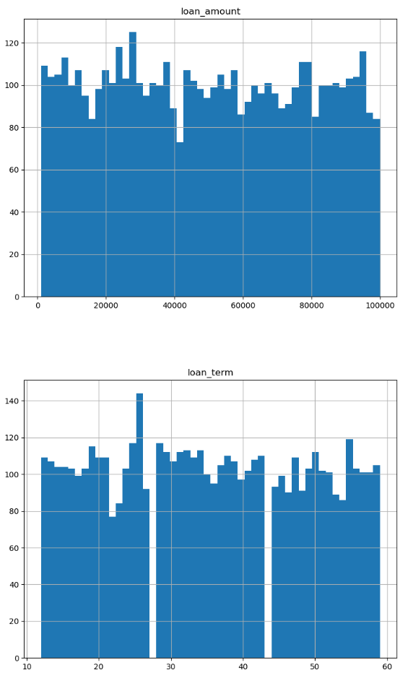
Exploratory Data Analysis (EDA)
Loan Amount:
The distribution of loan amounts appears to be relatively uniform, with no significant peaks
There is a slightly higher frequency of loans near the upper limit (close to $100,000).
Loan Term:
The loan term histogram shows a less uniform distribution with noticeable spikes.
Certain loan terms are more common, such as those around 15, 30, and 45 months.
There are gaps where certain loan terms are less frequent or possibly not present at all.

Slide 8
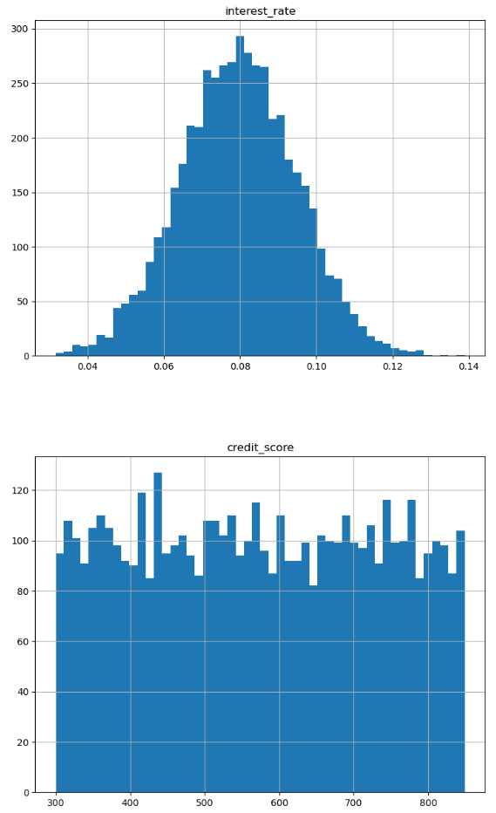
Exploratory Data Analysis (EDA)
Interest Rate:
The distribution of interest rates resembles a normal distribution, centered around 8%.
Most interest rates are clustered between 6% and 10%.
There are very few loans with interest rates below 4% or above 12%.
Credit Score:
The credit score distribution is fairly uniform, with some variation.
Credit scores range from around 300 to 850.

Slide 9
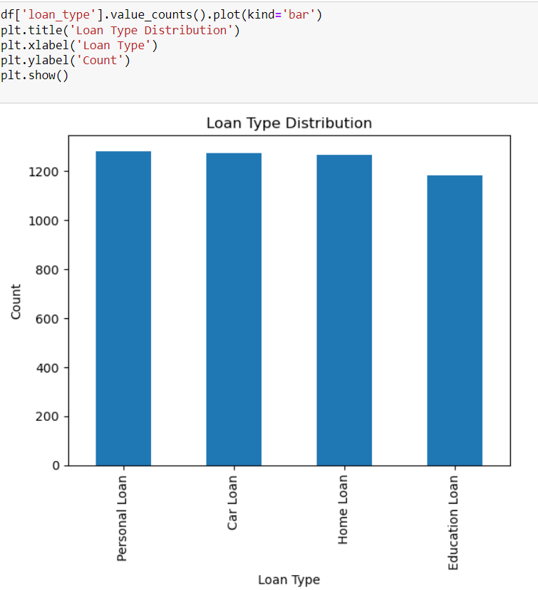
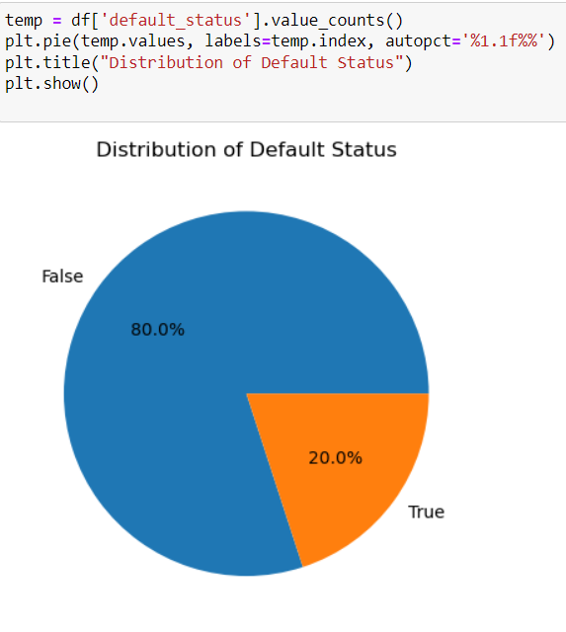
Exploratory Data Analysis (EDA)
We can also visualize the distribution of non numerical data
Loan type:
The distribution is fairly uniform with a slight dip for education loans.
Default Status:
Majority of total loans did not default 80%
20% of the total loans default

Slide 10
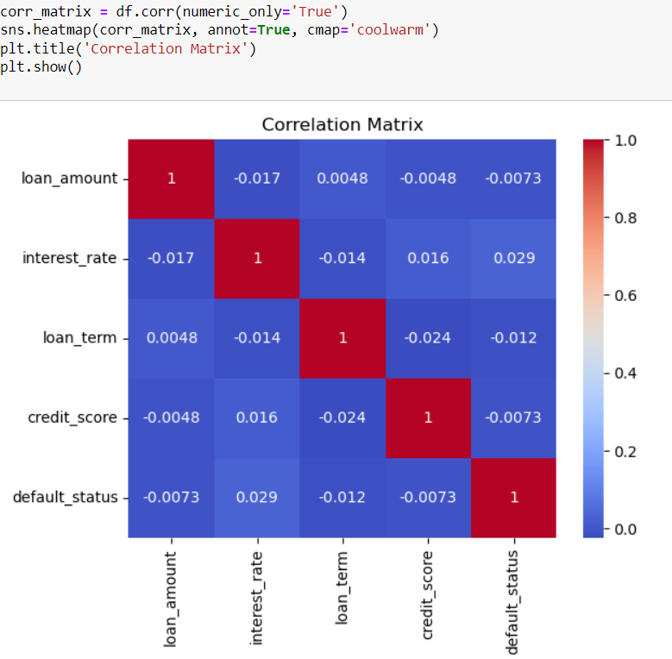
Exploratory Data Analysis (EDA)
The correlation matrix provided represents the relationships between different variables in the dataset.
Most of the correlations are weak, indicating that these variables are relatively independent. However, correlation does not imply causation; it only measures linear relationships.

Slide 11
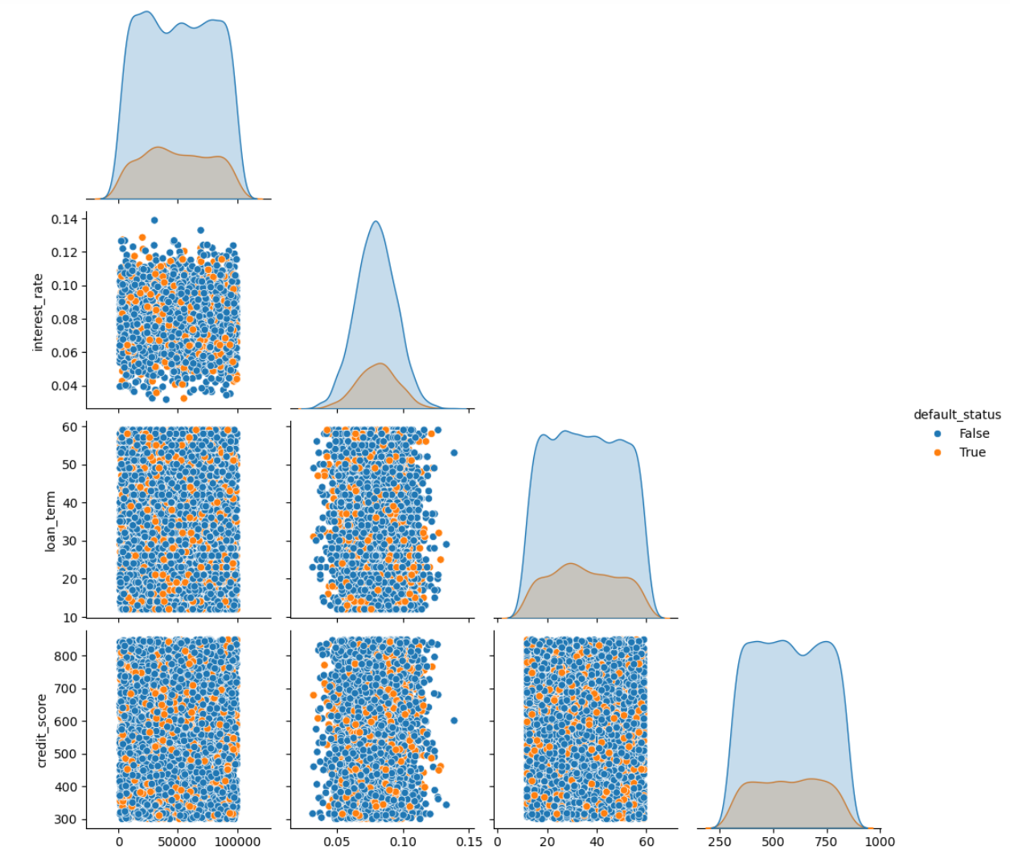
Exploratory Data Analysis (EDA)
By doing a pair plot analysis we can have insights into the relationships between different variables in the dataset.

Slide 12
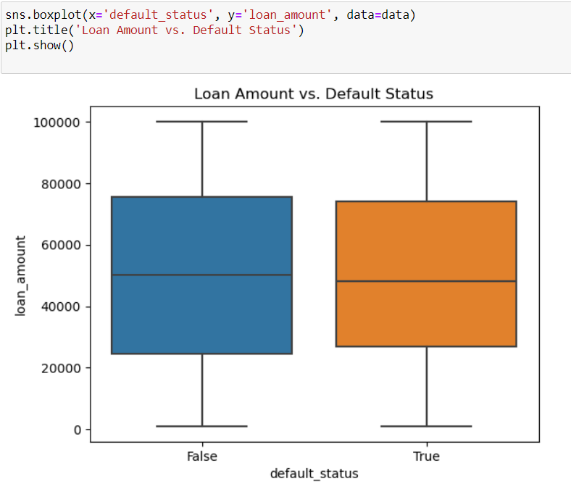
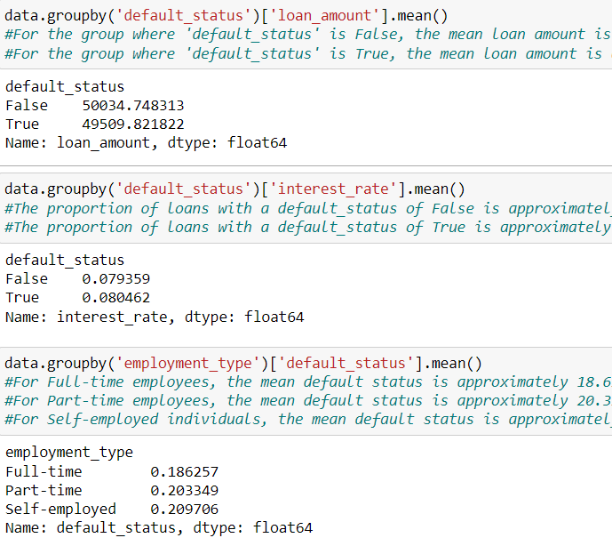
Exploratory Data Analysis (EDA)
Identifying relationships between default status, loan amount, interest rate and employment types.
The median loan amount is slightly lower for loans that defaulted compared to those that did not.
Overall distribution of loan amounts is quite similar between the two groups.
The default status for each category is relatively uniform.

Slide 13
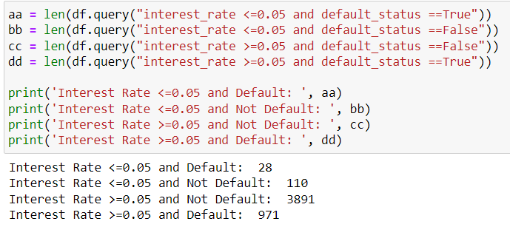
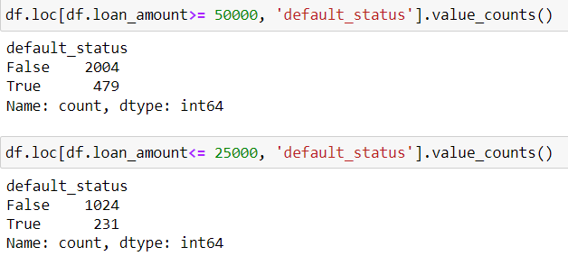
Exploratory Data Analysis (EDA)
The default rate for loans with an interest rate of 0.05 or less is approximately 20%. The default rate for loans with an interest rate greater than 0.05 is approximately 20%.
The data indicates that the interest rate, whether low (≤ 0.05) or high (> 0.05), does not significantly impact the likelihood of a loan defaulting
The default rate for loans with an amount of (>50k) or more is approximately 24%. The default rate for loans with an amount lesser than (50k<) is approximately 22.5%.
This indicates it also does not impact the likelihood of loan defaulting

Slide 14
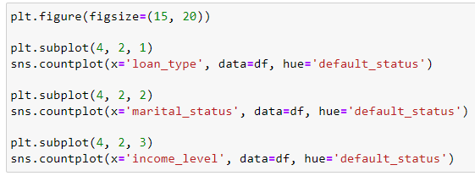
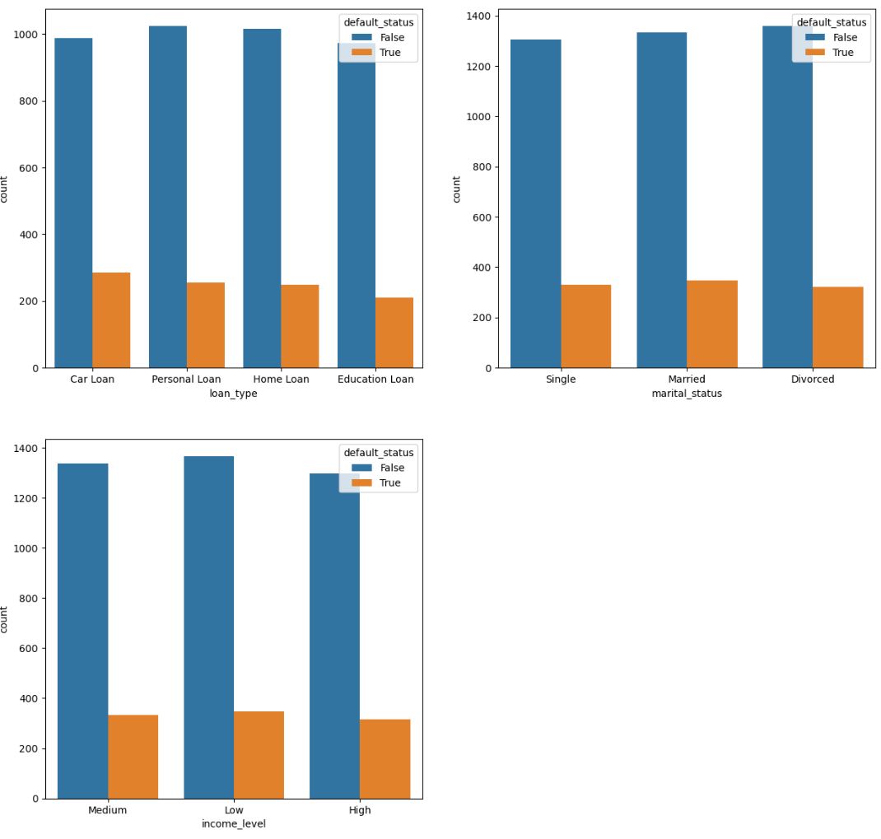
Exploratory Data Analysis (EDA)
Creating an overview of default status for loan types, marital status and income level
Loan Type:
It shows that “Car Loan” has the highest default count, followed by “Personal Loan,” “Home Loan,” and “Education Loan.”
Marital Status:
Default status is relatively uniform across
Income Level:
It shows that “Low” has the highest count followed by “Medium” and “High”.

Slide 15
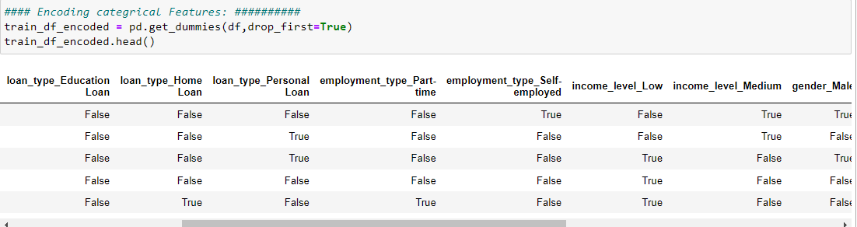
Model Building
Most machine learning algorithms, especially those based on linear algebra (like linear regression, logistic regression, neural networks, and many others), cannot directly handle categorical data. They require numerical input to perform mathematical computations.
We need to encode our dataset as it contains these categorical data.

Slide 16
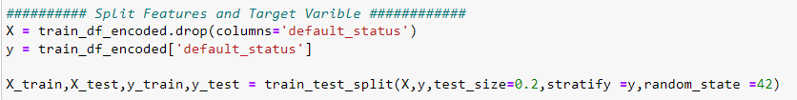
Model Building
We need to separate the dataset into features (input variables) and the target (output variable).
X: The feature matrix, containing all the input variables (features) except the target variable(default status)
Y: The target vector, containing the output variable (default status) that we want to predict.

Slide 17
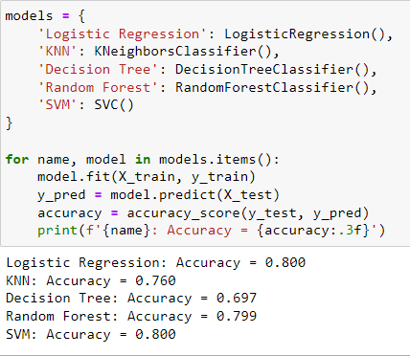
Evaluate Models
We use different machine learning models to evaluate the accuracy
Accuracy Results:
Logistic Regression: 0.800 (80.0%)
Support Vector Machine (SVM): 0.800 (80.0%)
Random Forest: 0.799 (79.9%)
K-Nearest Neighbors (KNN): 0.760 (76.0%)
Decision Tree: 0.697 (69.7%)

Slide 18
Conclusion
Logistic Regression, SVM, and Random Forest are the top-performing models with similar accuracies around 80.0%, making them the best candidates for predicting loan default status.
KNN is moderately effective, while the Decision Tree model performs the worst in this scenario. Further evaluation and tuning of the top models are recommended to ensure optimal performance.

